Slide 1

Project Quack
Presented by
The Bestagons
Notes:
Mimi

Slide 2
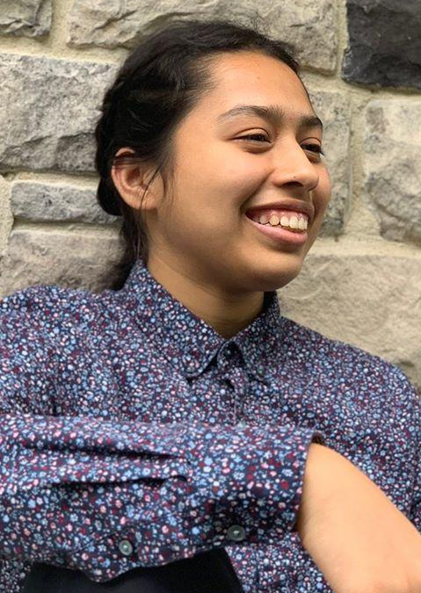
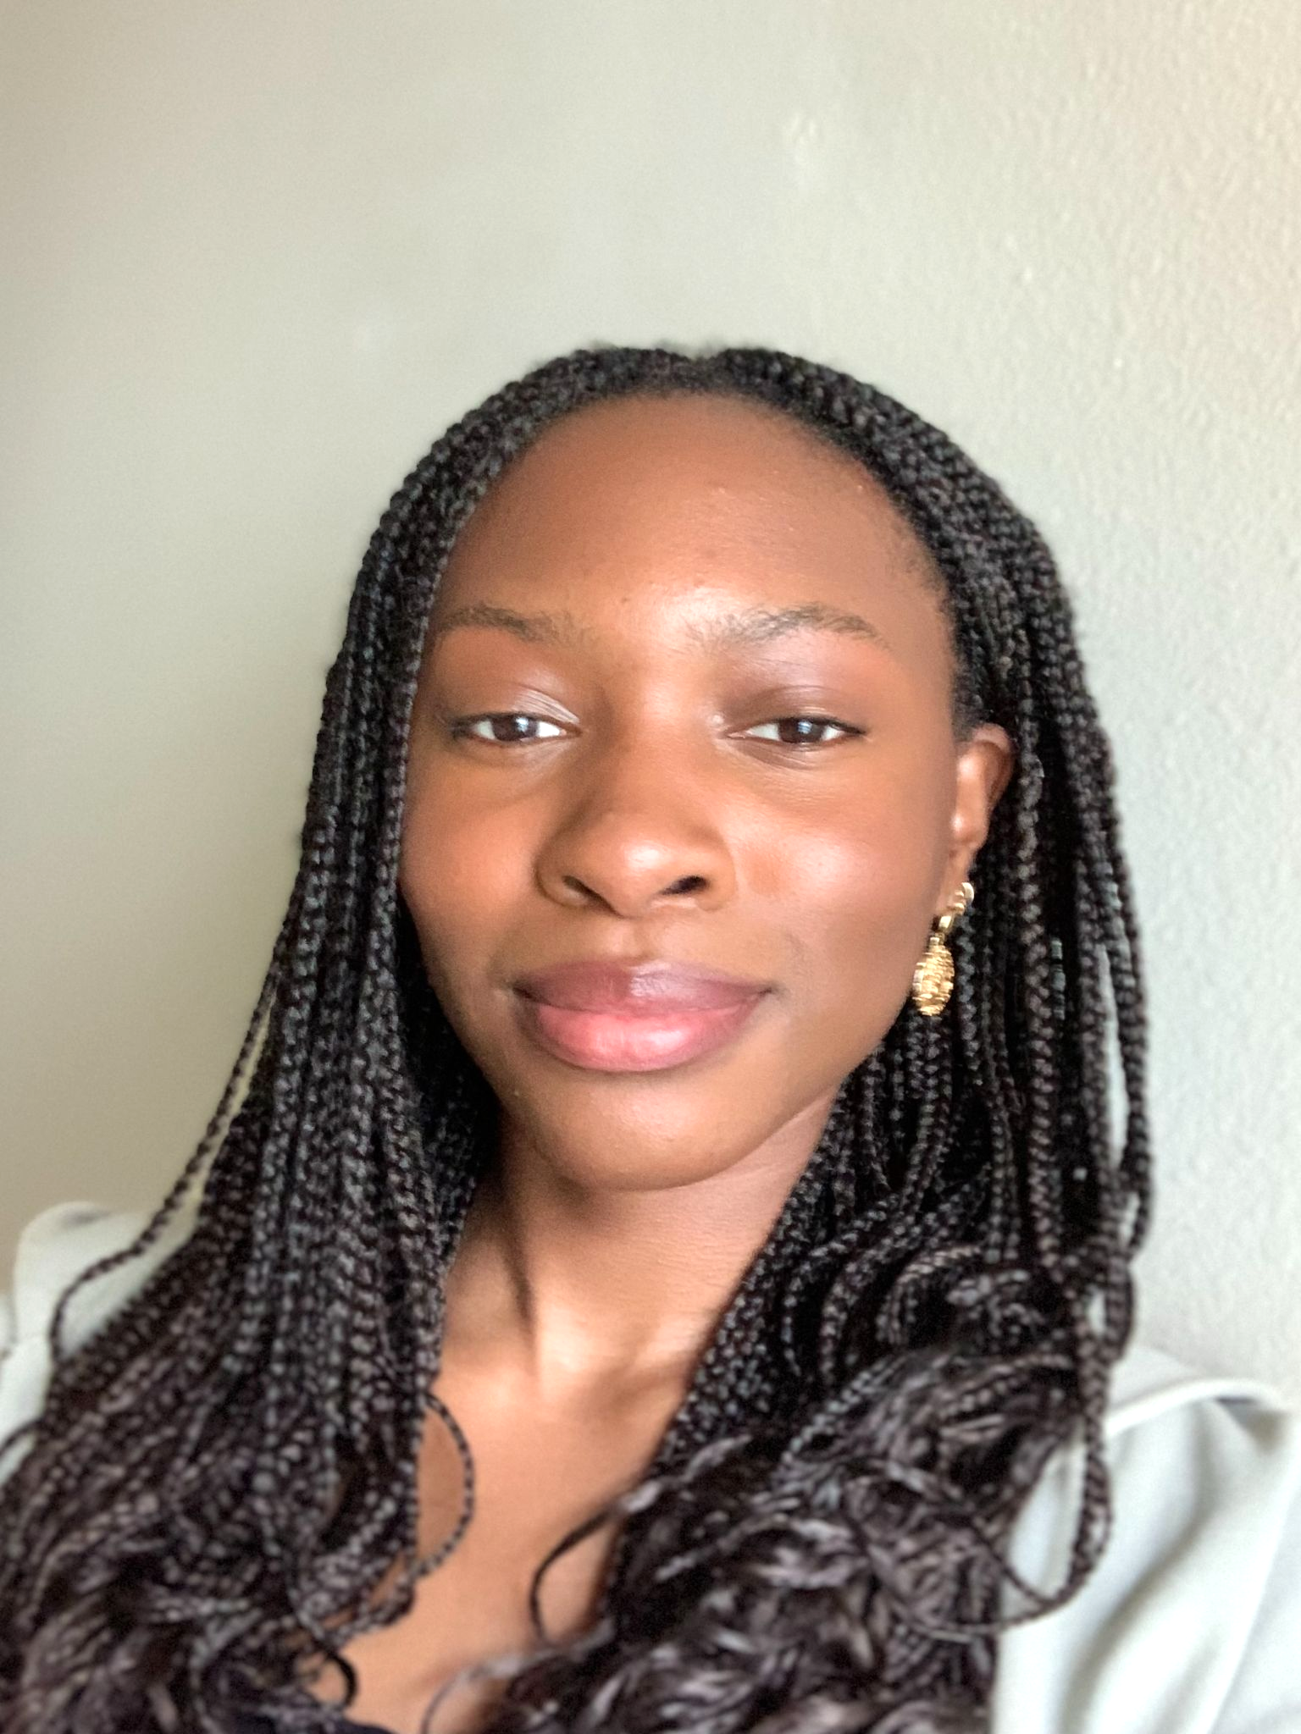
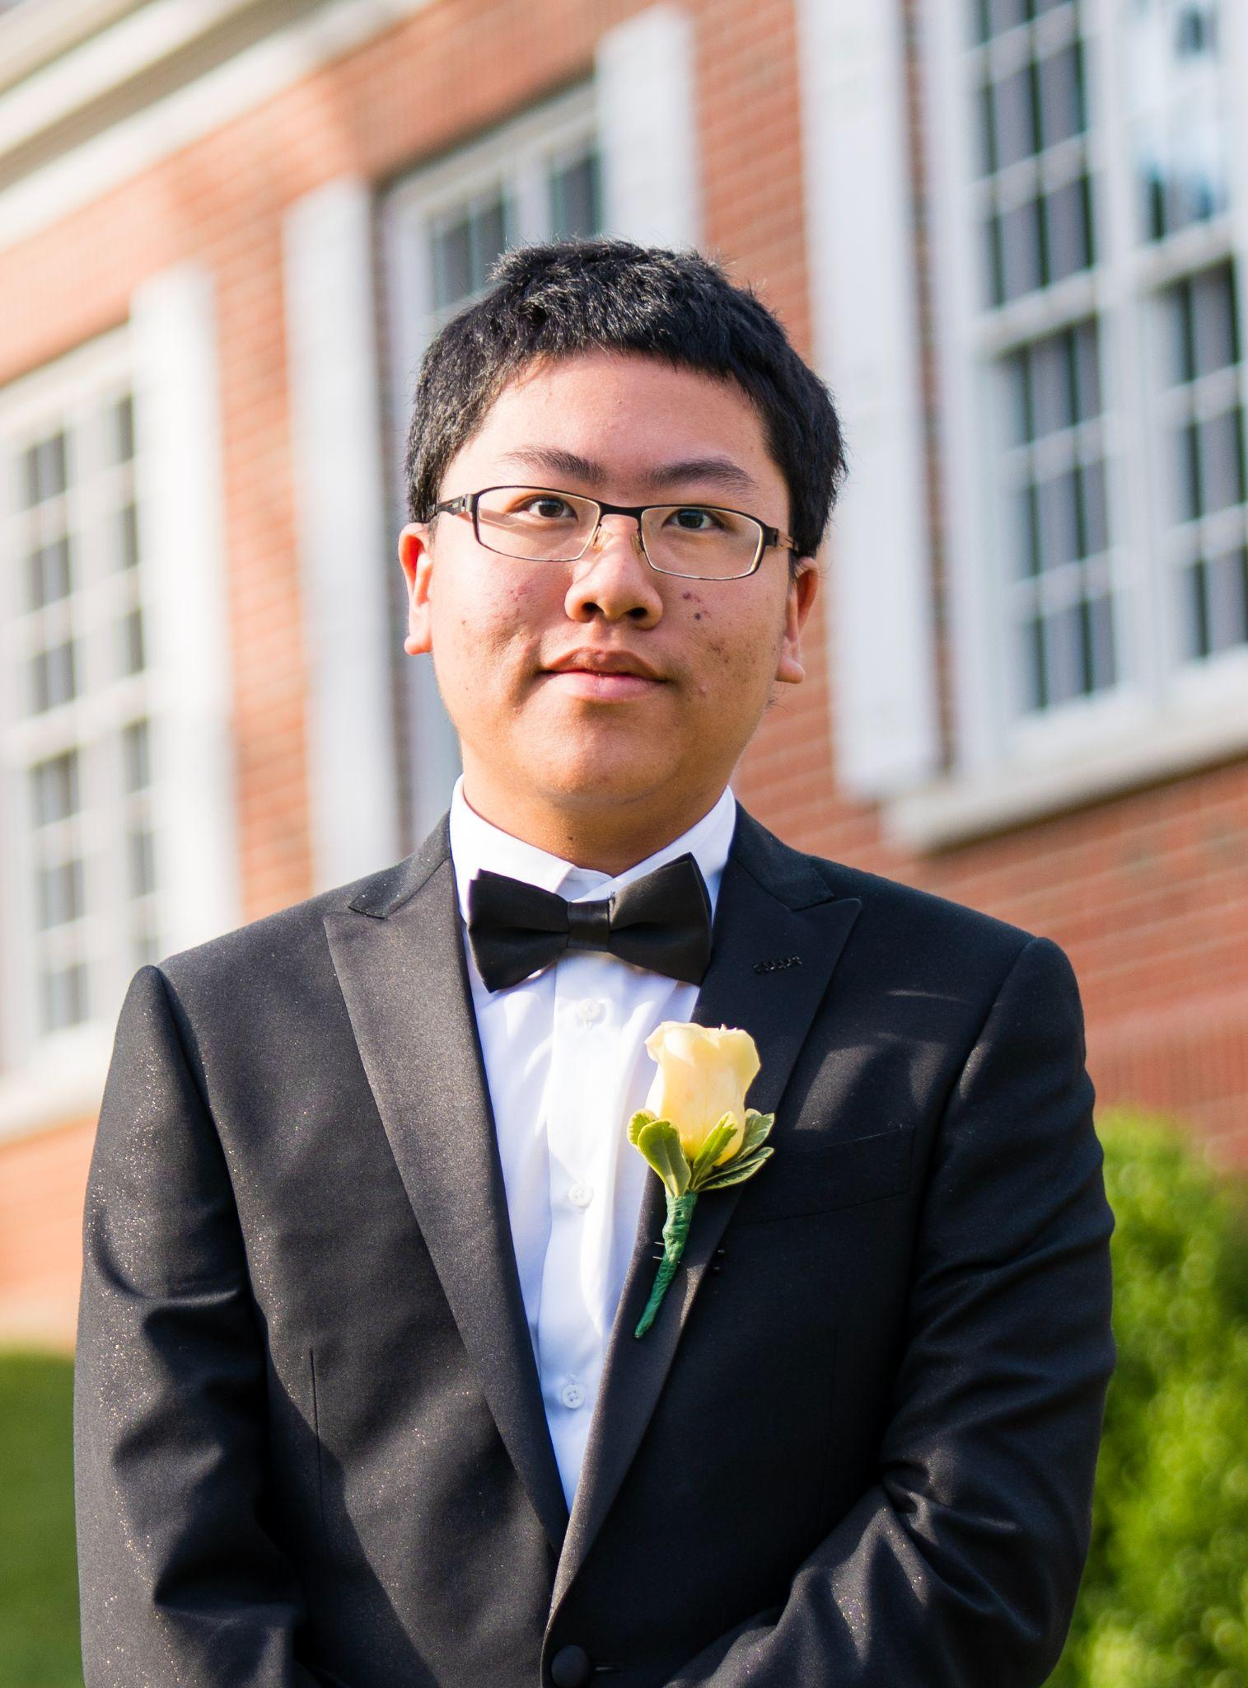
OUR TEAM
Mimi Olayeye
Brenda Cano
David Wei
Team Member
Team Member
Team member
Notes:
Mimi, Brenda, David

Slide 3
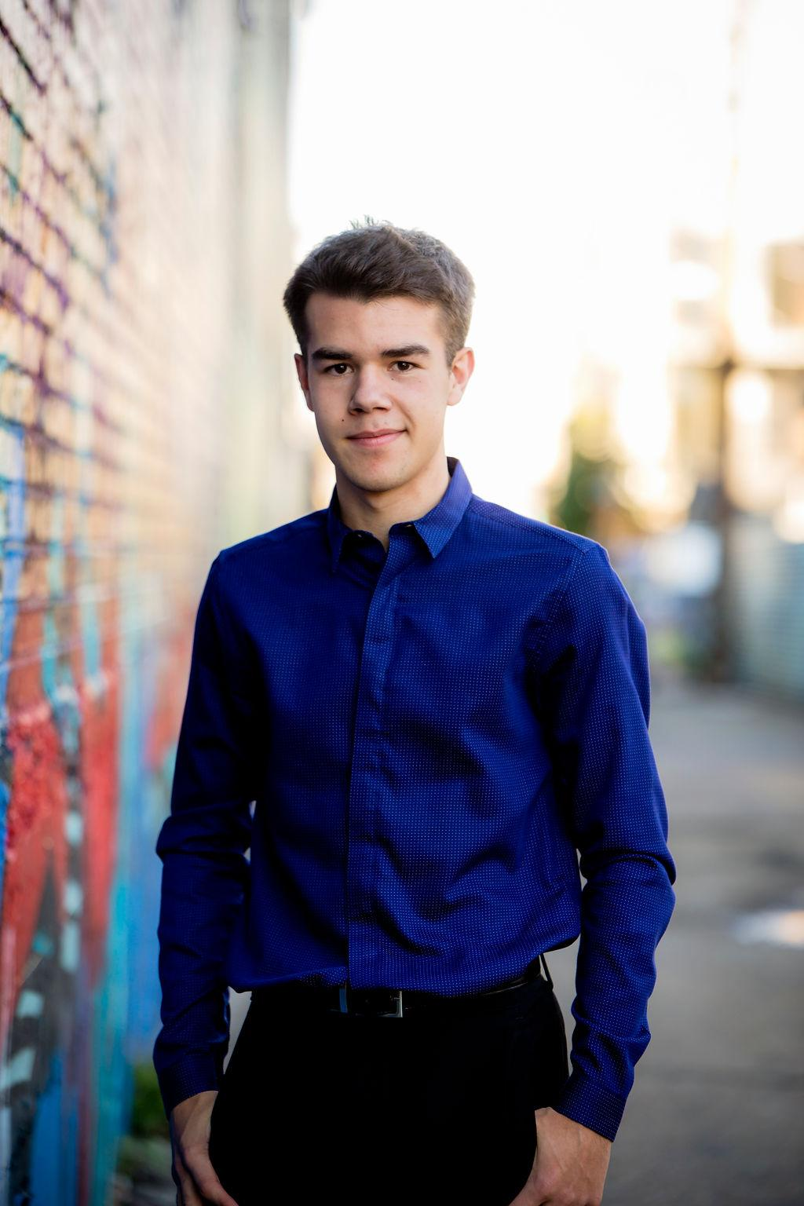


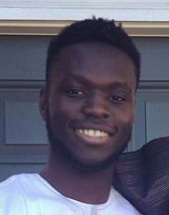
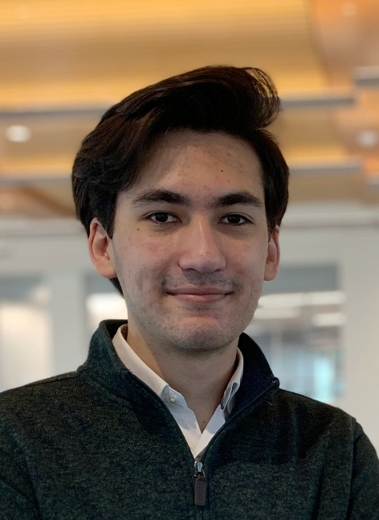
OUR TEAM
Ore Adenikinju
Miles Robertson
Rafael Piloto
Team member
Product Owner
Scrum Master
Notes:
Miles, Ore, Rafael

Slide 4
PROBLEM VS OUR SOLUTION (elevator pitch)
PROBLEM
SOLUTION
Returning from a pandemic, Emory University hasn’t quite figured out all the best systems yet. Coordinating a consistent student experience of classes and dining has yet to be achieved. Dining options are in flux and unclear.
An app that does all the thinking for you. Get notified when your favorite meals are served or when other friends are available to eat. Coordinate seating locations by viewing a heatmap of locations and see capacity statistics to beat rush hour and dine at the safest time.
Notes:
Ore

Slide 5
AGENDA
01
03
02
Acknowledging Feedback
What are our goals for the week?
What did we accomplish?
Notes:
Ore

Slide 6
01
Acknowledging Feedback
Notes:
Ore

Slide 7
Heat Map Clarification
Find open spots to sit in
Find safer spots to sit in
Usability
Installing Cameras is a proof of concept
Privacy Concerns? Use Waitz
It can be achieved without partnership using User Data (not very accurate)
Feasibility
Legal through partnership with Emory University
No PII data is stored in any manner!
Traffic is monitored in almost all public and commercial spaces today
Legality
Notes:
Rafael
Software to detect people can be implemented, but section data will be mocked to provide app functionality

Slide 8
Friends Feature
Link a “.ics” calendar link to your account
Find open times to dine for yourself and friends
See what section friends are seated in
Find a Time to Dine
Notes:
Ore

Slide 9
02
What did we accomplish?
Notes:
Rafael

Slide 10
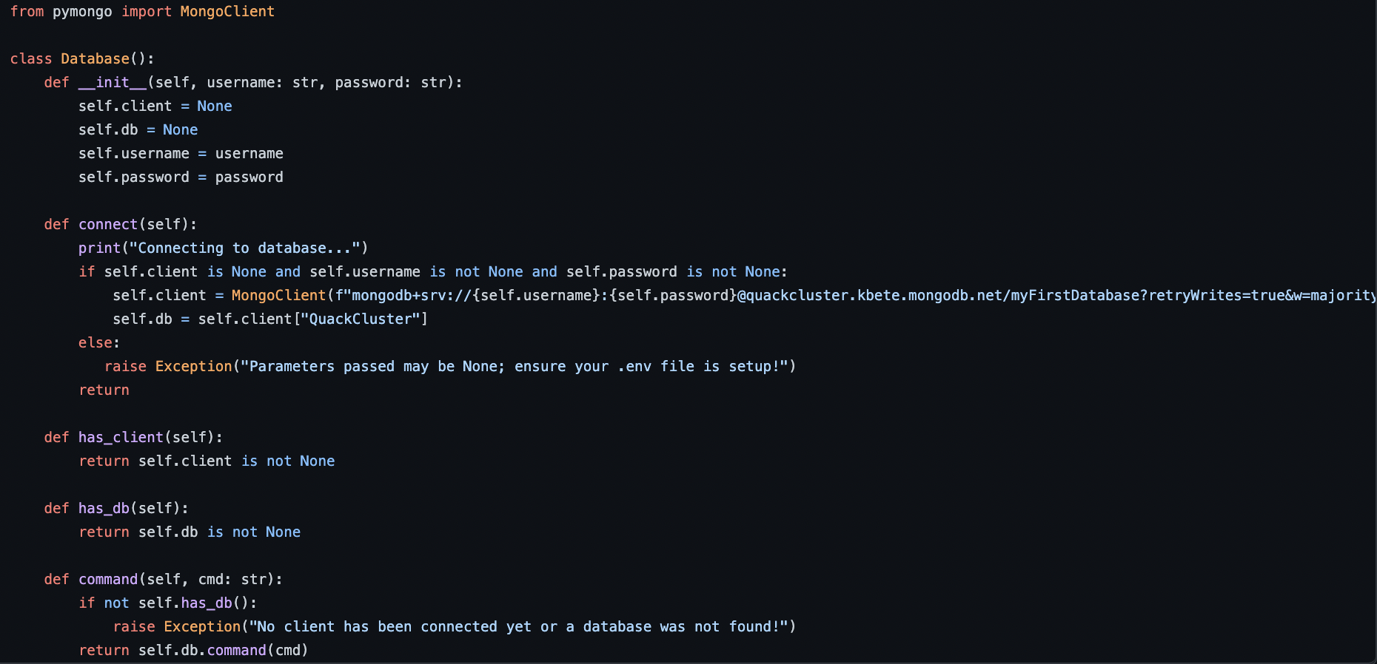
Connected Database
Notes:
Rafael

Slide 11
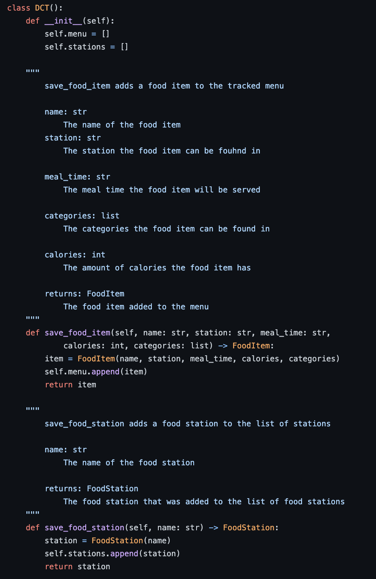
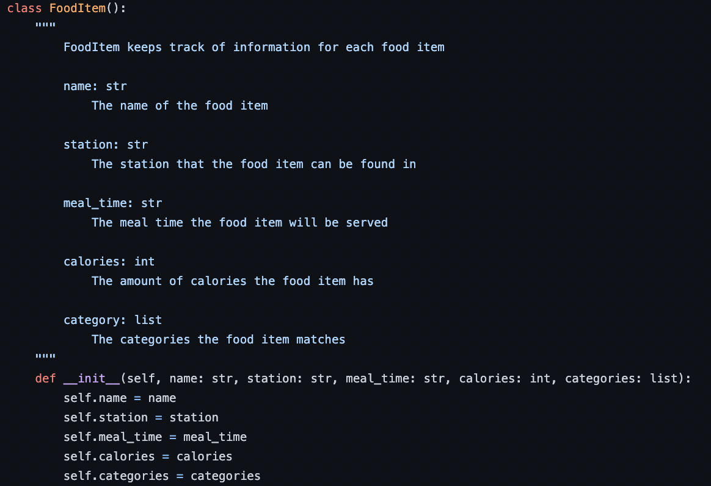
DCT Backend Data Structure
Notes:
Rafael

Slide 12
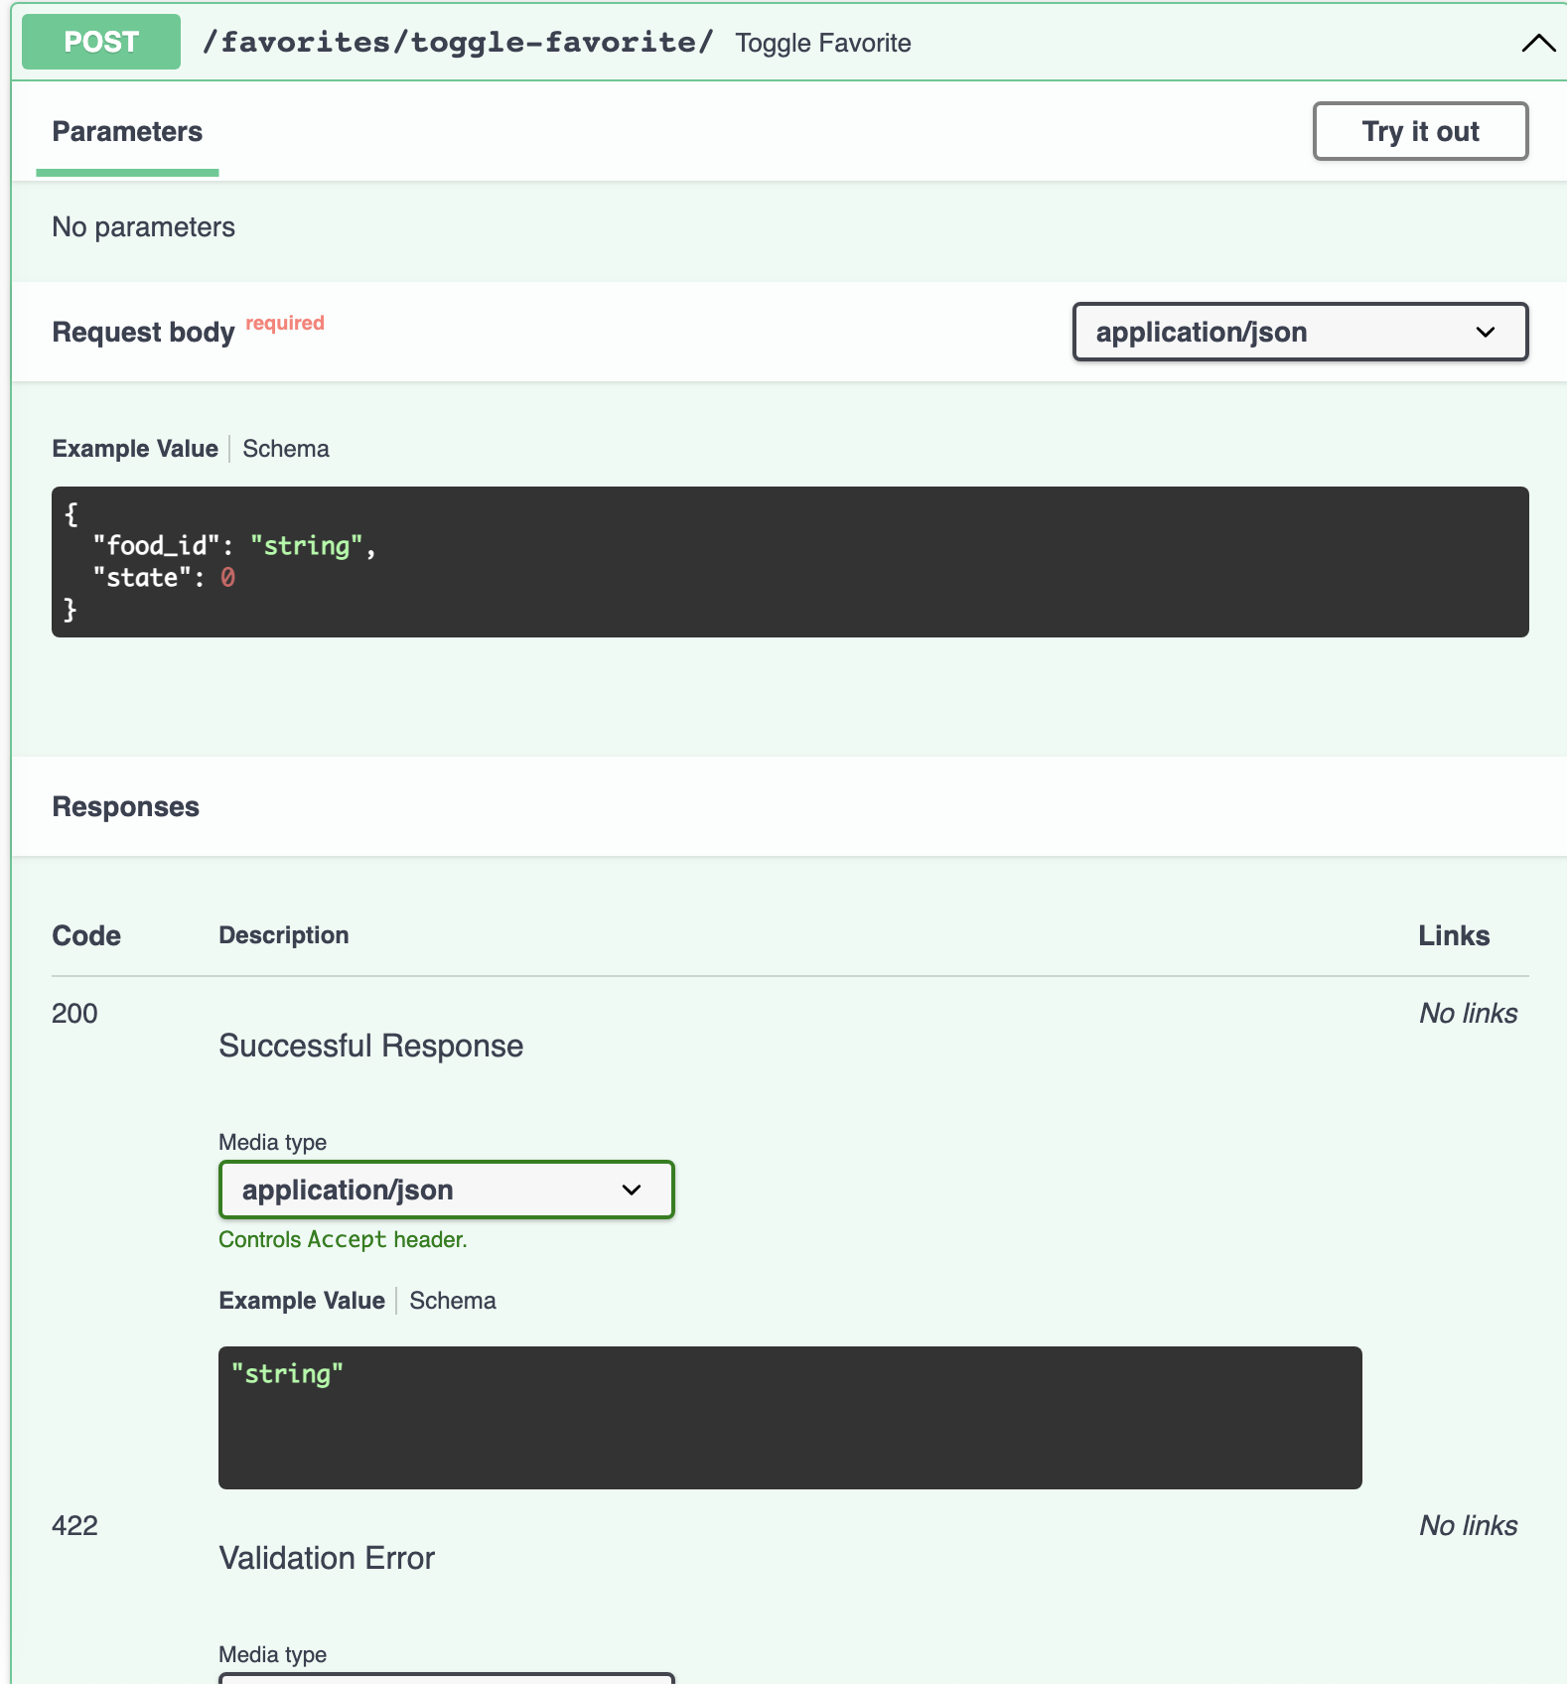
Save Favorite Food in Database
Error handled
Tests written
Restructured backend using blueprints
Notes:
David

Slide 13
Save DCT Food Stations in DCT Backend
Keep track of the food stations to use for other areas within the app
Notes:
Brenda

Slide 14
Save DCT Capacity in DCT Backend
Keep track of the current capacity of the DCT which includes:
Takeout
Students who are getting food but plan to eat outside of the dining hall
Dine-in
Students who are getting food but plan to eat inside the dining hall
Total Capacity
The total number of students currently in the dining hall
Notes:
Brenda

Slide 15
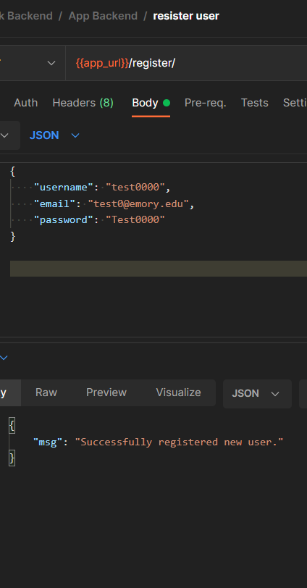
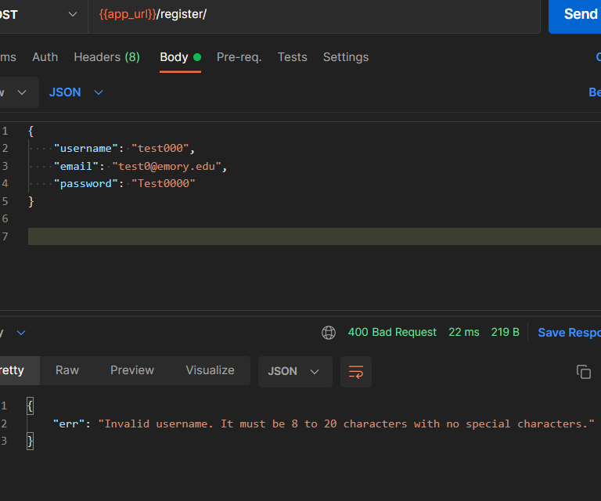
App Backend Register User
Example of an error response
Example of a success response
Notes:
Brenda

Slide 16
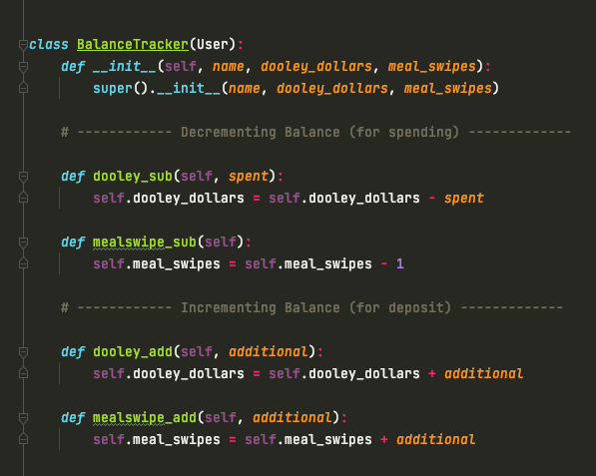
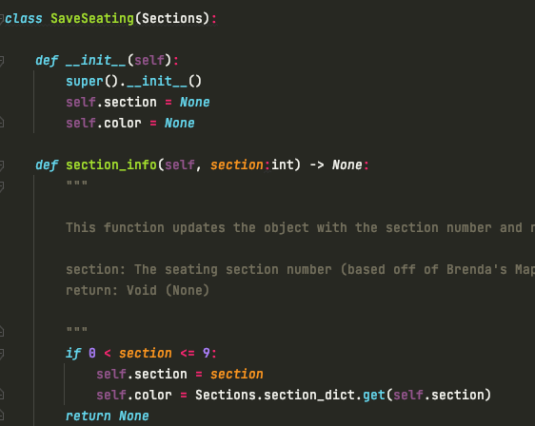
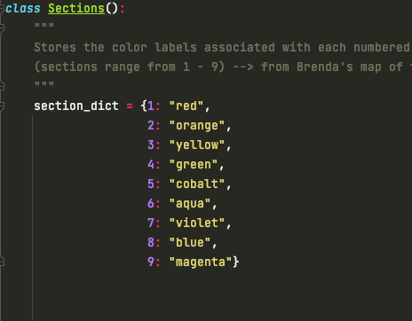
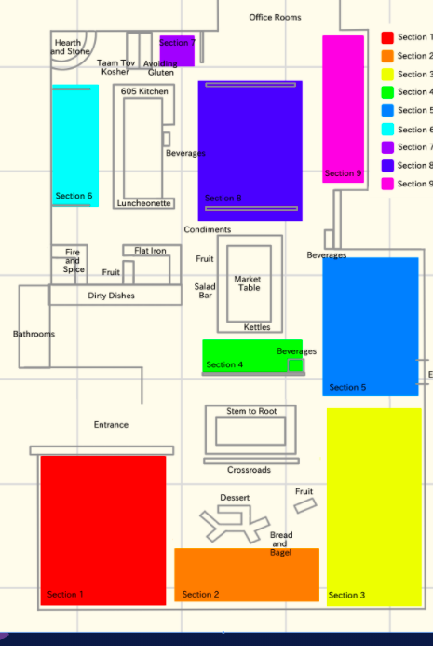
App back-end updates
Balance Tracker:
Keeps track Dooley Dollars and meal swipes
Refactored my code from last week
Peer-review changes
Save-Seated-Section
Keeps track seating
Peer-review changes
Notes:
Mimi

Slide 17
Web Scraper Timeline
First Successful Scrape
Html.parser, soup.find(), print(mealmenu)
Install
Research
More Scrapes
Save to Backend
GitHub, Requests, BeautifulSoup
Base URL, Inspect-Element
Get more data (ex: mealtimes, food-items, stations)
Connect to helper methods created by team
Notes:
Miles

Slide 18
Scraper Demo!
Notes:
Miles

Slide 19
Pair Programming
WHO
Miles & Rafael
NEW IDEAS
We preferred when the less-familiar member was the Driver
CODING
Observer having their own browser open was useful for troubleshooting and inspecting the Bon Appetit website to help search for key elements
Other pair programming will occur in future sprints
Notes:
Miles

Slide 20
03
What are our goals for the week?
Notes:
Miles

Slide 21
4 points
behind schedule!
Notes:
Miles

Slide 22
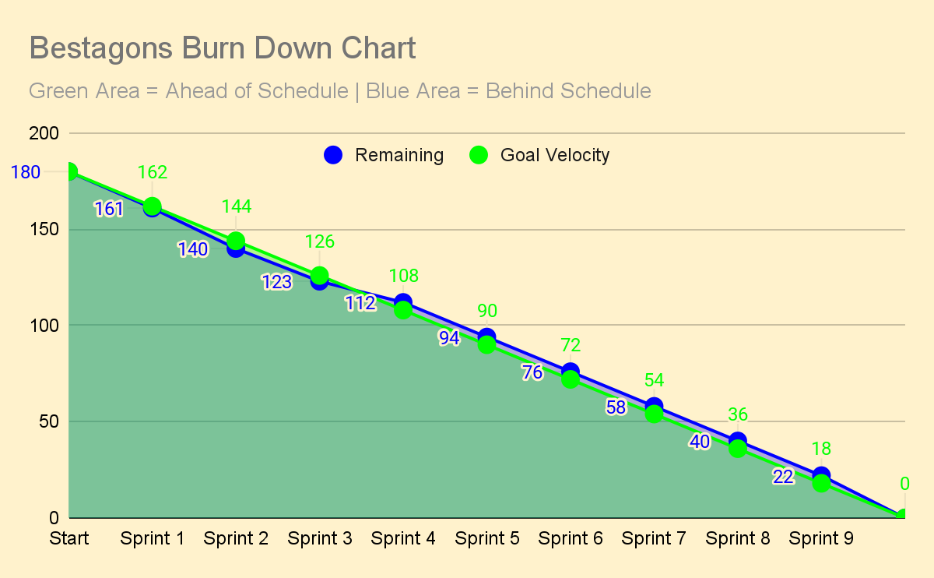
Notes:
Miles
Notes: It was fall break; we will catch up in next two sprints

Slide 23
THANKS
Please remember to share your feedback :)

